Slide 1
Car rental System

Slide 2
Introduction
Northgate Vehicle Hire is a car renting company based in the United Kingdom with branches across Europe. Its registered office is Northgate center Darlington in Durham.
The company owns vans and vehicles which it rents out to other companies and individuals.
They are able to get the vehicles to the clients at a faster speed as a result of having a big fleet that is spread across 60 branches.
They offer different hiring options depending on the need of the clillent

Slide 3
System design
The company uses an online system to facilitate and manage the rental of the fleet of vehicles
The company allows the clients to make a booking of the vehicle through a phone call or through the website
A client then makes a down-payment for the rental and the booking is confirmed
If a call is made, the assistant in the company makes the booking on behalf of the client. Otherwise the booking is made by the client and the booking approved for rent by the branch manager or staff member

Slide 4
Use case diagram

Slide 5
System implementation
The use case diagram indicates the functionalities that are available to the customers, branch manager, and the staff.
The actions that they are able to undertake are listed in the use case diagram.
The users of the system need a user account in order to access the system.
The use case diagram describes additional functionalities that the system is able to undertake.
The entities and their attributes are listed. Furthermore, an entity relationship diagram is also developed.

Slide 6
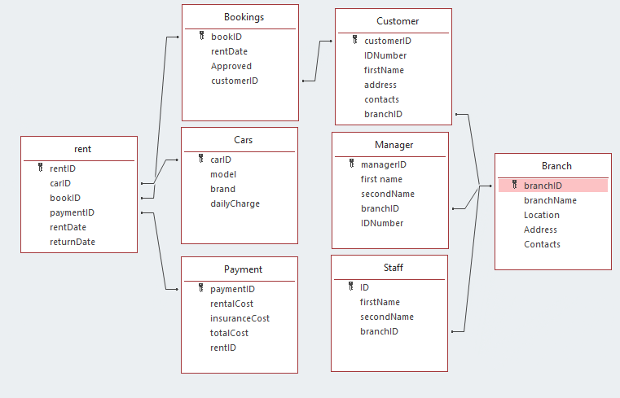
System entities and their attributes

Slide 7
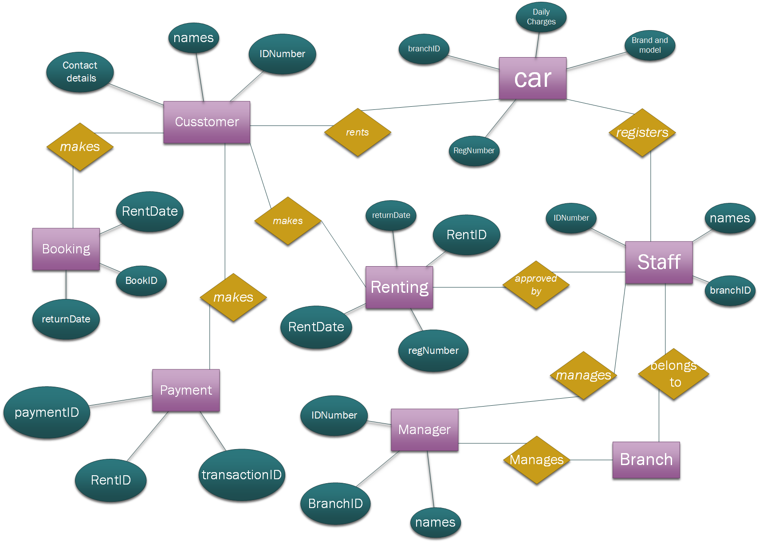
Entity relationship diagram

Slide 8
Project plan
The project can be implemented through a one year project that will be used to implement the online system.
The system will be developed through the prototyping methodology.
The project team will be chosen from the IT staff at the company and also from a pool of IT experts.
The project sponsor will be Northgate company as they will be the owners of the system

Slide 9
Project plan
The prototypes will be developed and tested with a single branch and a few vehicles
Every time a prototype is developed, the testing will be undertaken to ensure that it provides optimum solution
Once a prototype meets the requirements, it will be fully developed and implemented throughout the branches.
The implementation will also involve user training so as to ensure that they understand the system well.

Slide 10
Conclusion
In conclusion, the Northgate car rental system is a good system but requires a few adjustments.
The company and its operations has been described including how the current system works
A proposed online car rental system designed has also been indicated and the procedures of implementation indicated
The project plan of the system implementation is also outlined.

